Slide 1
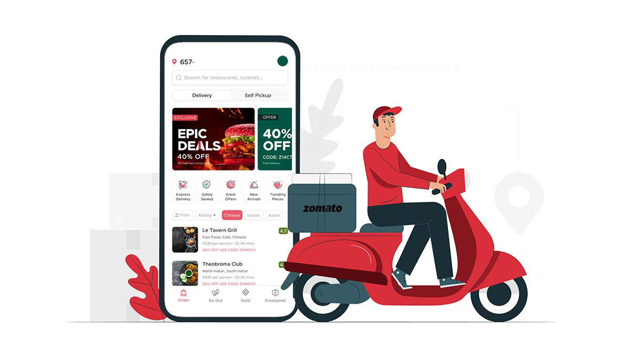
Capstone Project (UNSUPERVISED ML)
ZOMATO RESTAURANT CLUSTERING AND SENTIMENT ANALYSIS
TEAM
IQBAL BABWANE
SAMEER ANSARI
LUKMAN HAIDER KHAN
~ UNDER THE GUIDANCE OF TEAM ALMABETTER

Slide 2

CONTENT
INTRODUCTION OF PROJECT
PROBLEM STATEMENT
DATA DESCRIPTION
EDA
FEATURE ENGINEERING
NLP OPERATIONS
MACHINE LEARNING MODELS
CONCLUSION

Slide 3
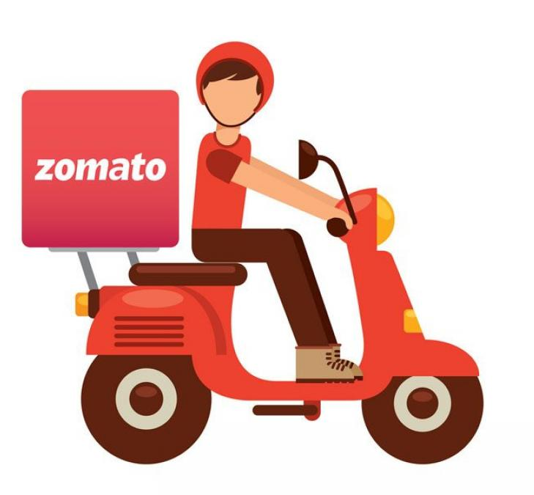
INTRODUCTION
Zomato is an Indian restaurant aggregator and food delivery start-up founded by Deepinder Goyal and PankajChaddah in 2008. Zomato provides information, menus and user-reviews of restaurants, and also has food delivery options from partner restaurants in select cities.

Slide 4
PROBLEM STATEMENT
Zomato is an Indian restaurant aggregator and food delivery start-up founded by Deepinder Goyal and Pankaj Chaddah in 2008. Zomato provides information, menus and user-reviews of restaurants, and also has food delivery options from partner restaurants in select cities.
India is quite famous for its diverse multi cuisine available in a large number of restaurants and hotel resorts, which is reminiscent of unity in diversity. Restaurant business in India is always evolving. More Indians are warming up to the idea of eating restaurant food whether by dining outside or getting food delivered. The growing number of restaurants in every state of India has been a motivation to inspect the data to get some insights, interesting facts and figures about the Indian food industry in each city. So, this project focuses on analyzing the Zomato restaurant data for each city in India.
The Project focuses on Customers and Company, you have to analyze the sentiments of the reviews given by the customer in the data and made some useful conclusion in the form of Visualizations. Also, cluster the Zomato restaurants into different segments. The data is visualized as it becomes easy to analyze data at instant. The Analysis also solve some of the business cases that can directly help the customers finding the Best restaurant in their locality and for the company to grow up and work on the fields they are currently lagging in.
This could help in clustering the restaurants into segments. Also the data has valuable information around cuisine and costing which can be used in cost vs. benefit analysis
Data could be used for sentiment analysis. Also the metadata of reviewers can be used for identifying the critics in the industry.

Slide 5

DATA DESCRIPTION -The dataset contains two data Zomato Restaurant names and Metadata and Zomato Restaurant reviews
Data Description – 1
- Zomato Restaurant names and Metadata Attribute Information:
Name : Name of Restaurants
Links : URL Links of Restaurants
Cost : Per person estimated Cost of dining
Collection : Tagging of Restaurants w.r.t. Zomato categories
Cuisines : Cuisines served by Restaurants
Timings : Restaurant Timings

Slide 6
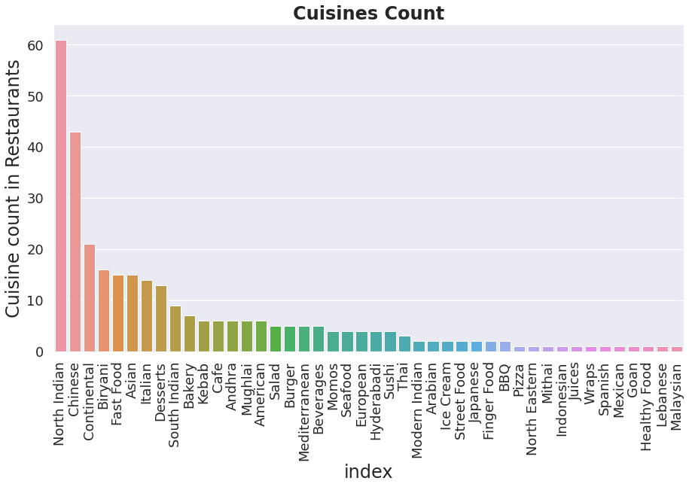
EDA
North Indian is the most popular cuisine

Slide 7
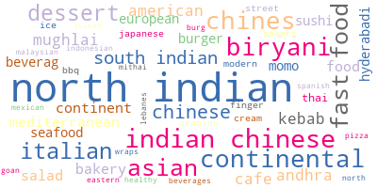
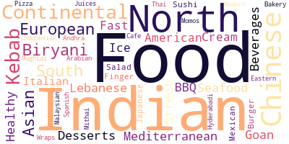
WORDCLOUD
Visualization of words from 'Cuisines' feature
Most nominated words from 'Cuisine' feature

Slide 8
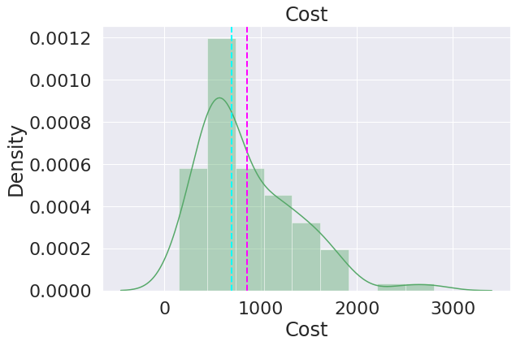
EDA
Distribution of cost column

Slide 9
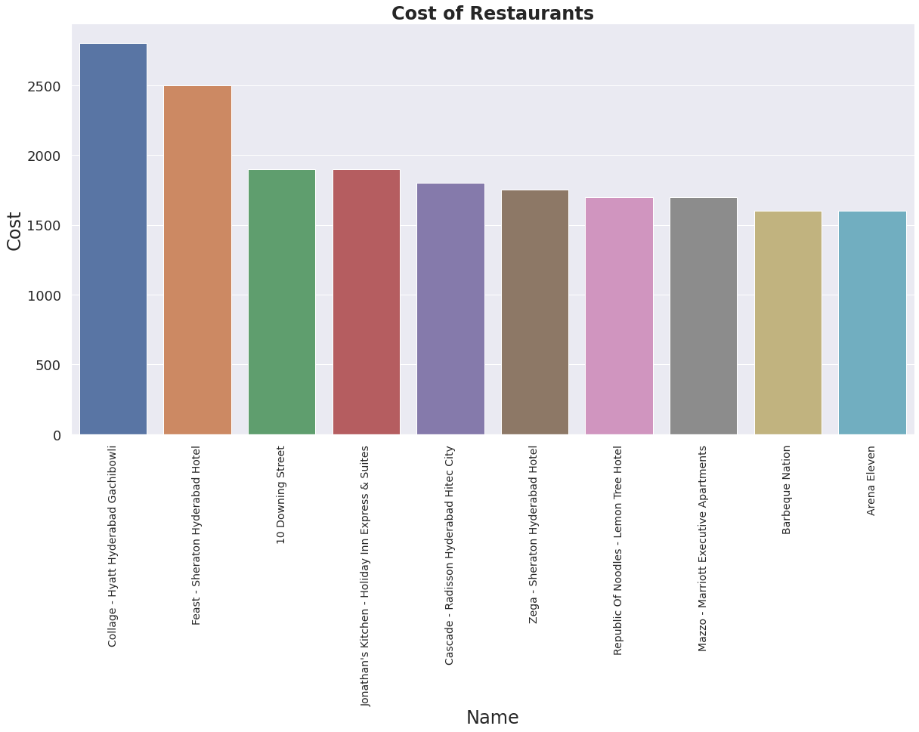
EDA
Collage - Hyatt Hyderabad Gachibowli is the expensive restaurant with cost of 2800

Slide 10
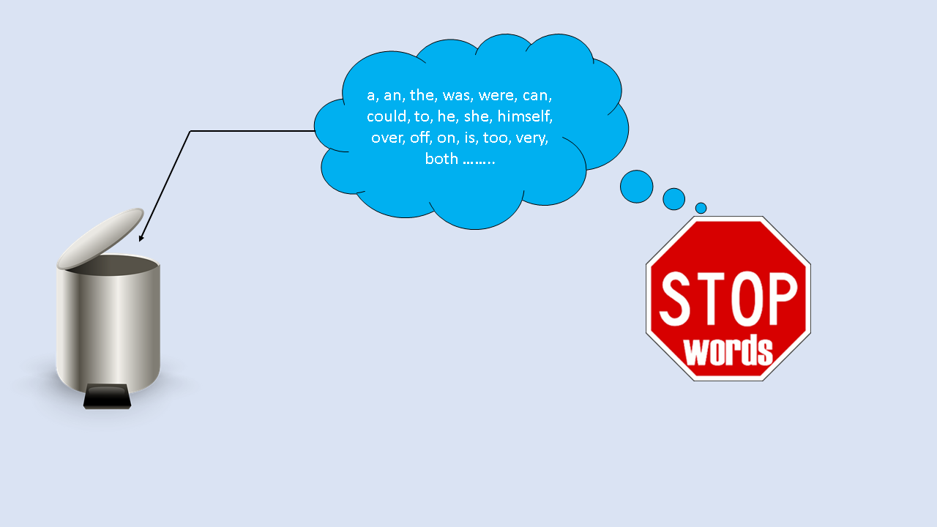
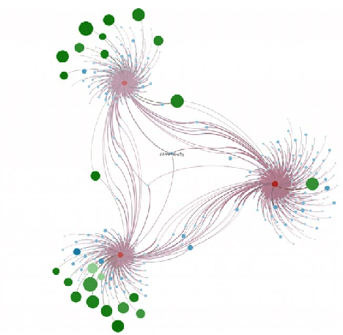
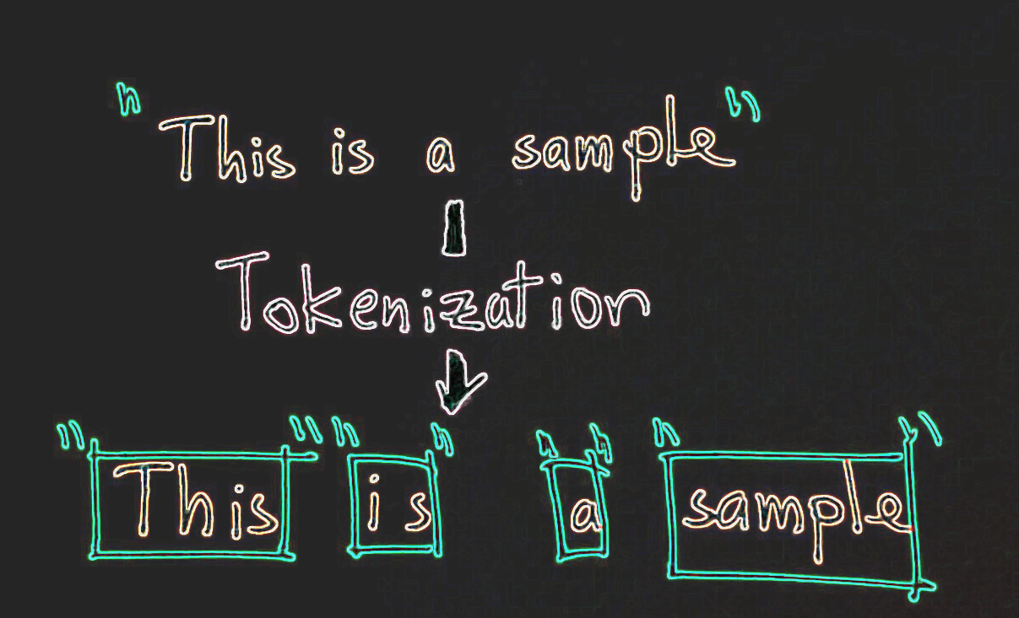
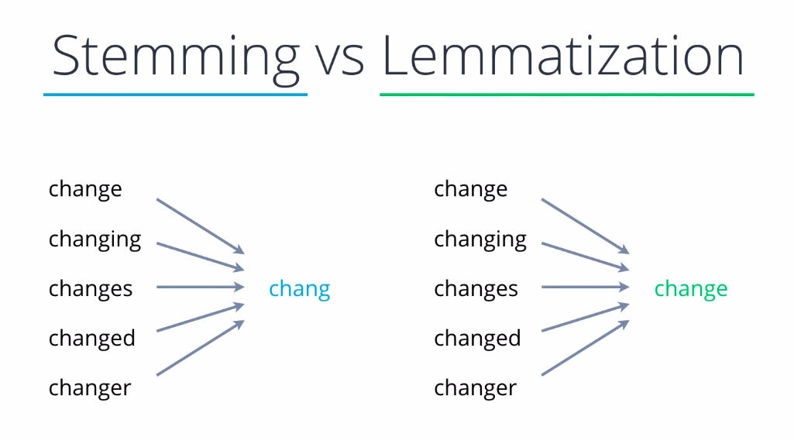
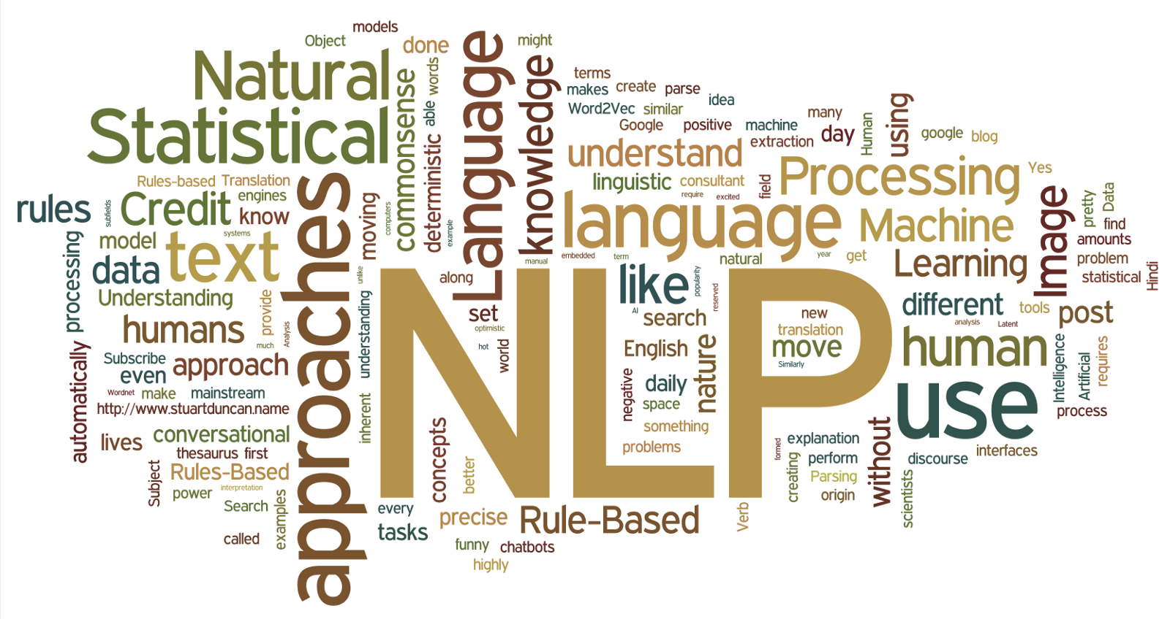
Topic modelling
Stop words
Techniques
NLP

Slide 11
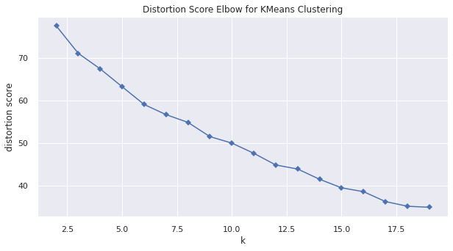
Elbow method to find appropriate 'K' value
Since here elbow occurs from 10 onwards, we can take k = 15 as optimum value

Slide 12
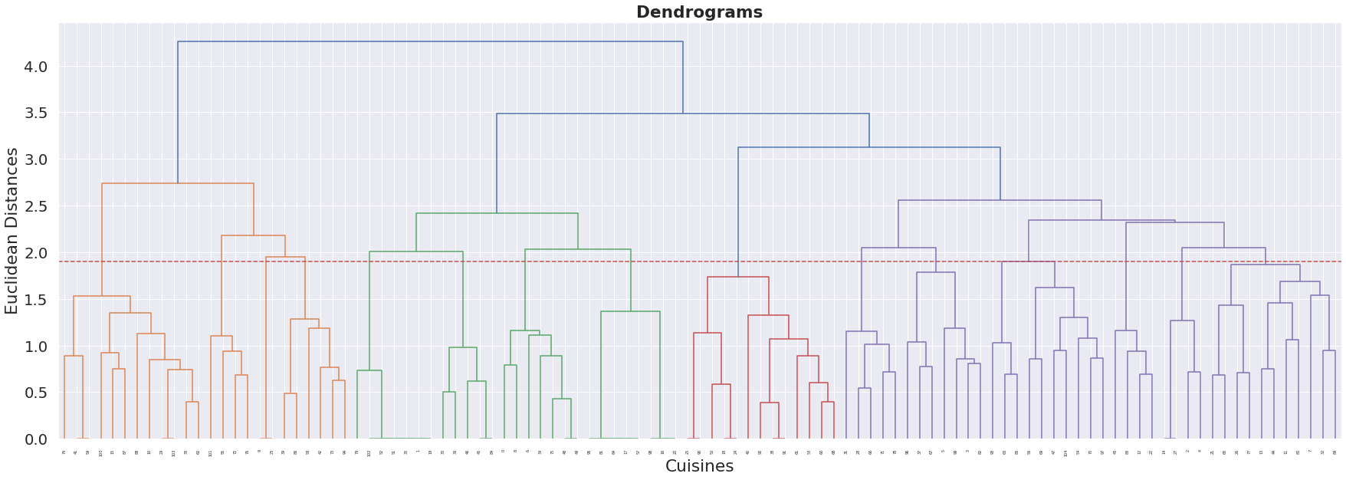
By using Agglomerative Clustering, we came with the above dendrograms. At Euclidean Distance of 1.8, we got best cluster 15 with silhouette score of 0.238

Slide 13
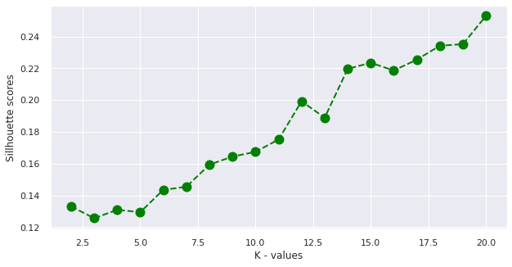
SILHOUETTE SCORE OF CLUSTERS
From the above graph we can take k = 15 as optimum value of silhouette score

Slide 14
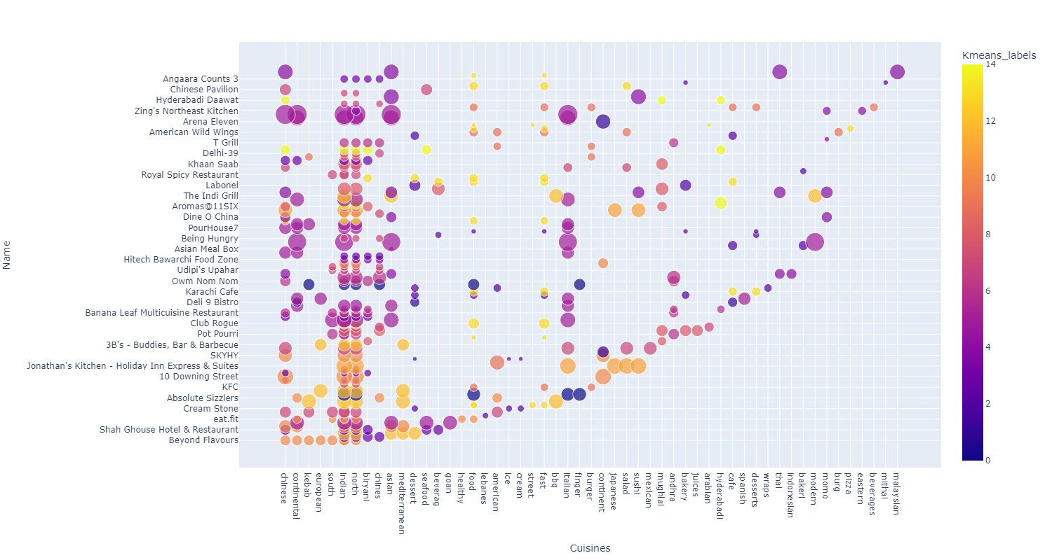
Clusters of K-Means Clustering

Slide 15
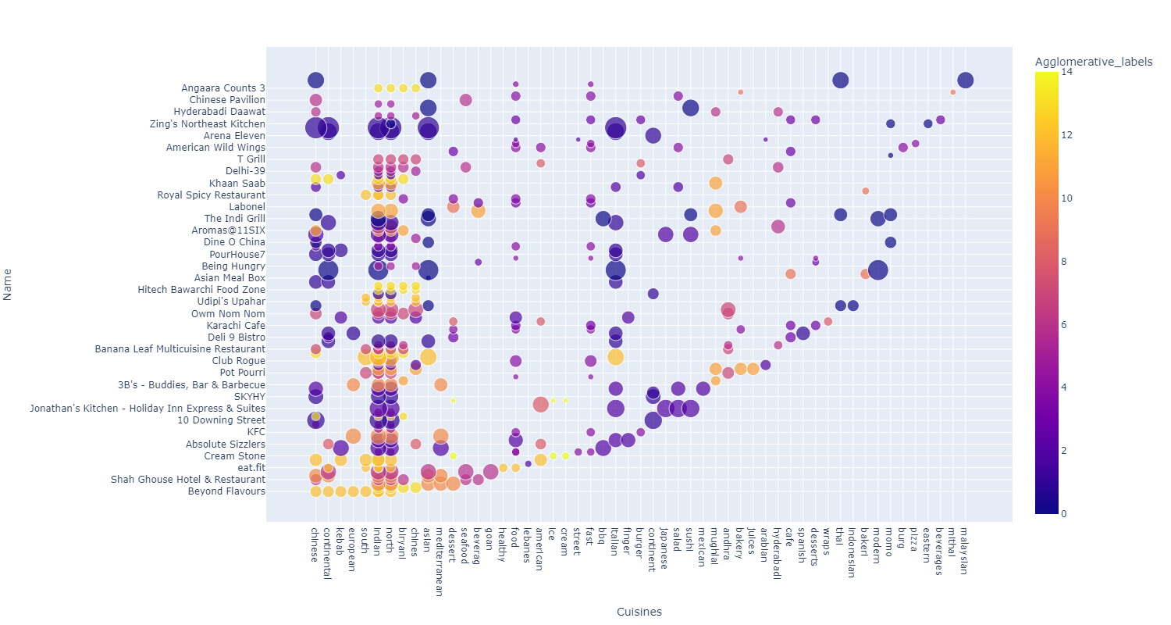
Clusters of Agglomerative Clustering

Slide 16
Data Description – 2
- Zomato Restaurant reviews
Restaurant : Name of the Restaurant
Reviewer : Name of the Reviewer
Review : Review Text
Rating : Rating Provided by Reviewer
MetaData : Reviewer Metadata - No. of Reviews and followers
Time: Date and Time of Review
Pictures : No. of pictures posted with review

Slide 17
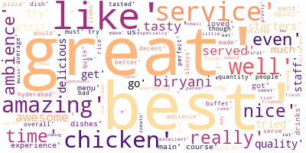
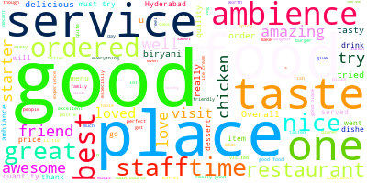
WORDCLOUD
Wordcloud for all Reviews
Wordcloud for Reviews for more than
3 ratings

Slide 18
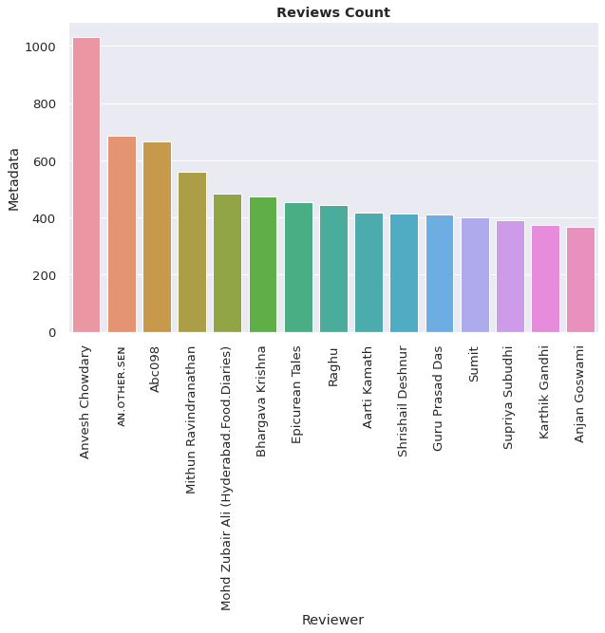
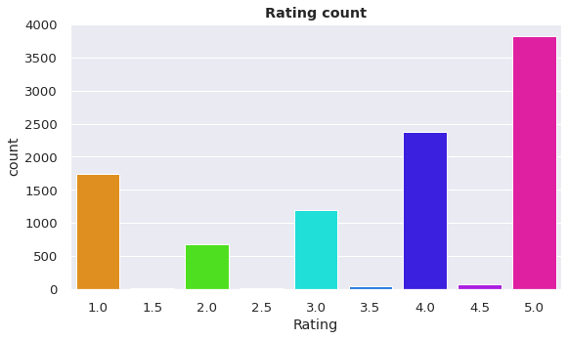
EDA
5.0 has maximum number of Ratings
Anvesh Chowdary is the customer which has given reviews most of the time

Slide 19
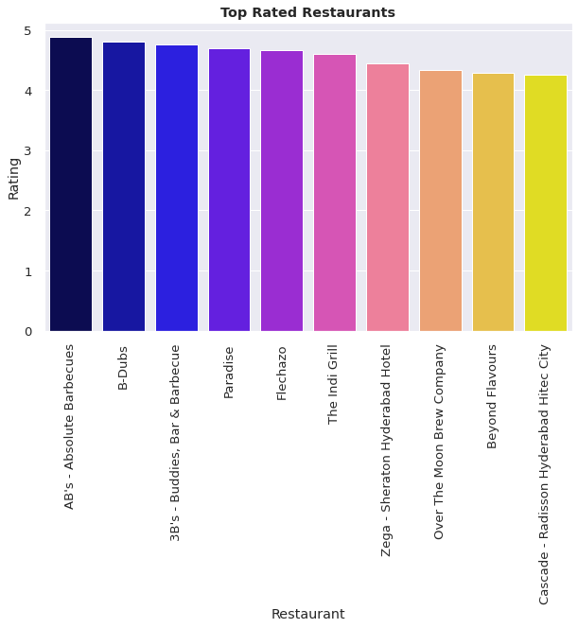
EDA
Top 10 restaurants with highest rating,
where, AB’s – Absolute Barbecues is leading among all

Slide 20
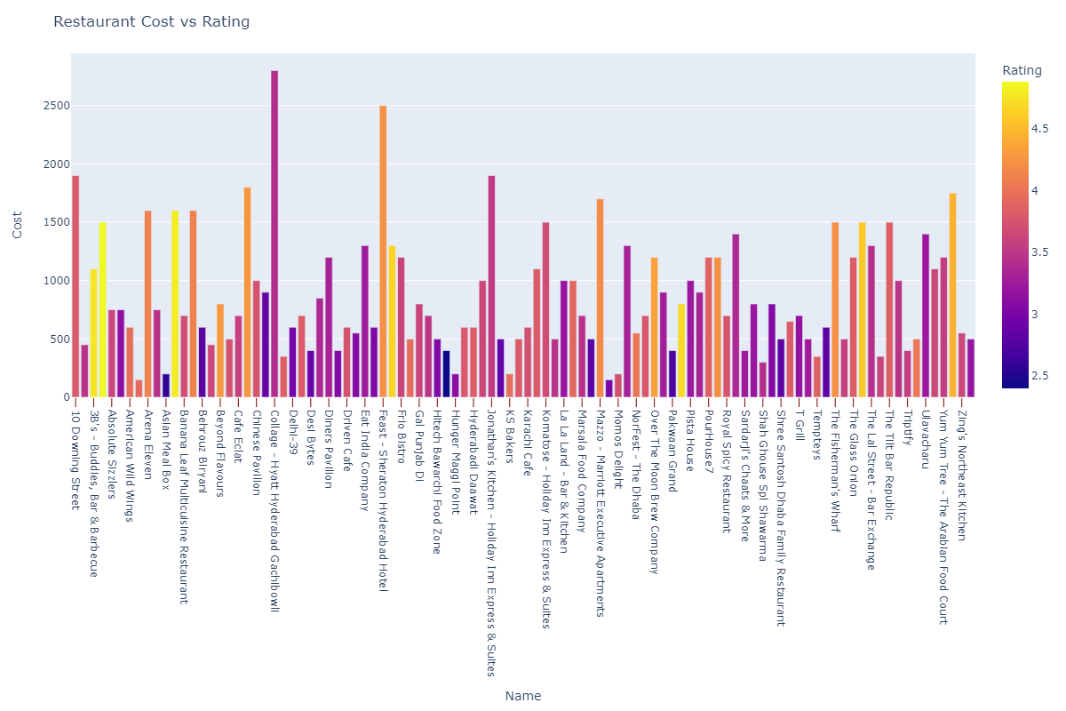
Sentiment Analysis

Slide 21
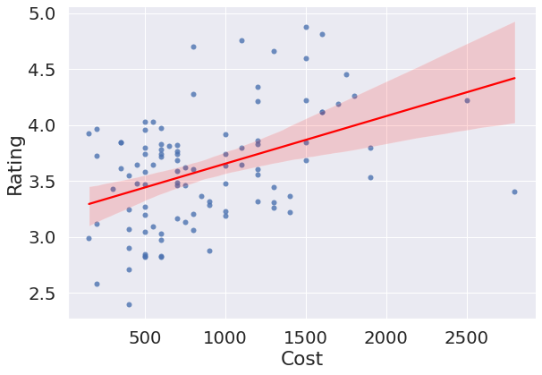
Correlation of Rating and Cost
Here we can see that rating is highly and positively correlated with cost

Slide 22
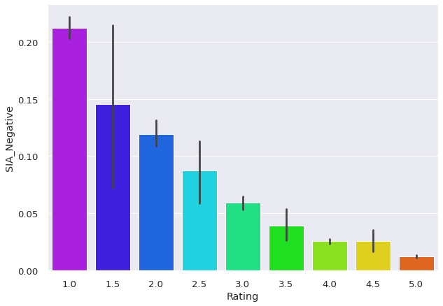
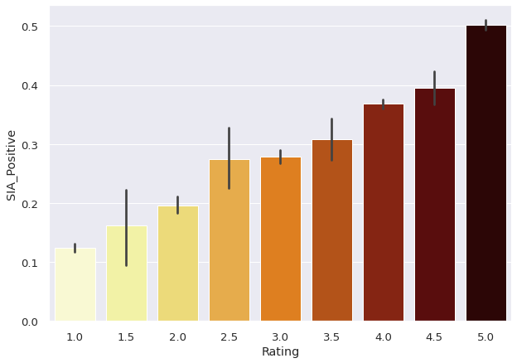
Sentiment Intensity Analyzer
Negative polarity
Positive polarity

Slide 23
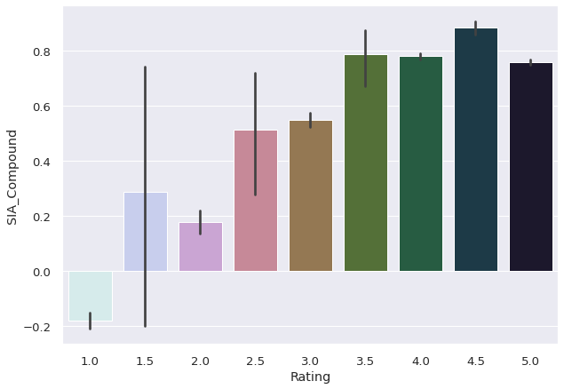
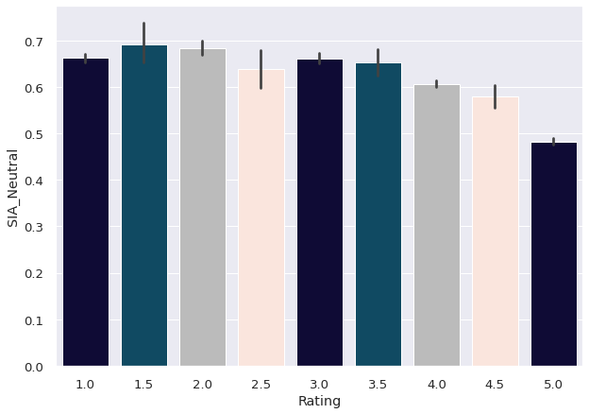
Sentiment Intensity Analyzer
Compound polarity
Neutral polarity

Slide 24
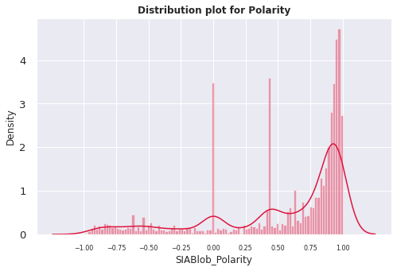
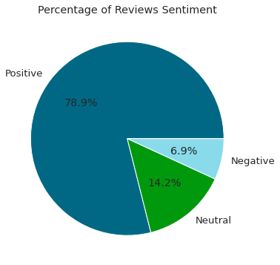
Distribution plot for polarity
Percentage of Reviews Sentiment
Positive polarity is quite high followed by neutral
Negative polarity density is very low i.e. 6.9%

Slide 25
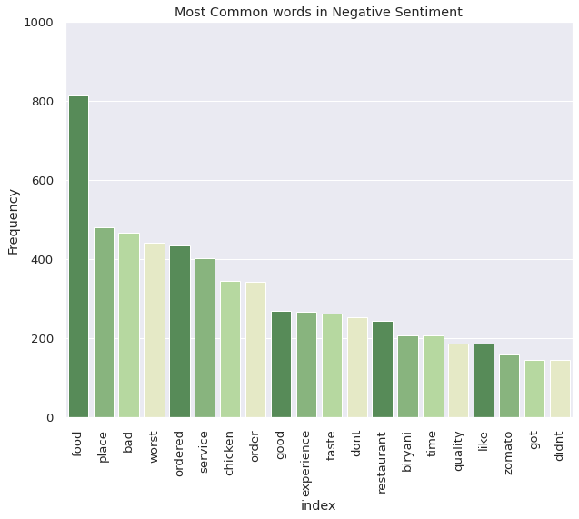
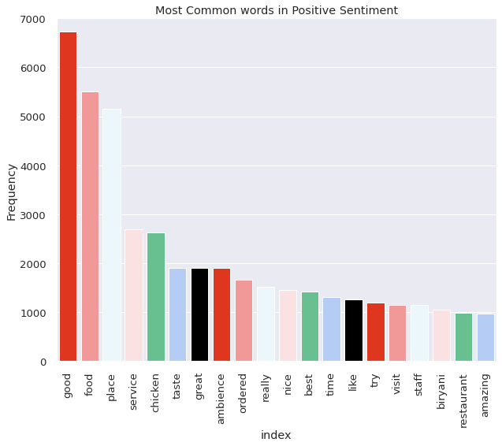
Most Common words in Negative Sentiment
Most Common words in Positive Sentiment
From all the negative sentiments we separate the words which has repeated many time
From all the positive sentence we separate the words which has repeated many time

Slide 26
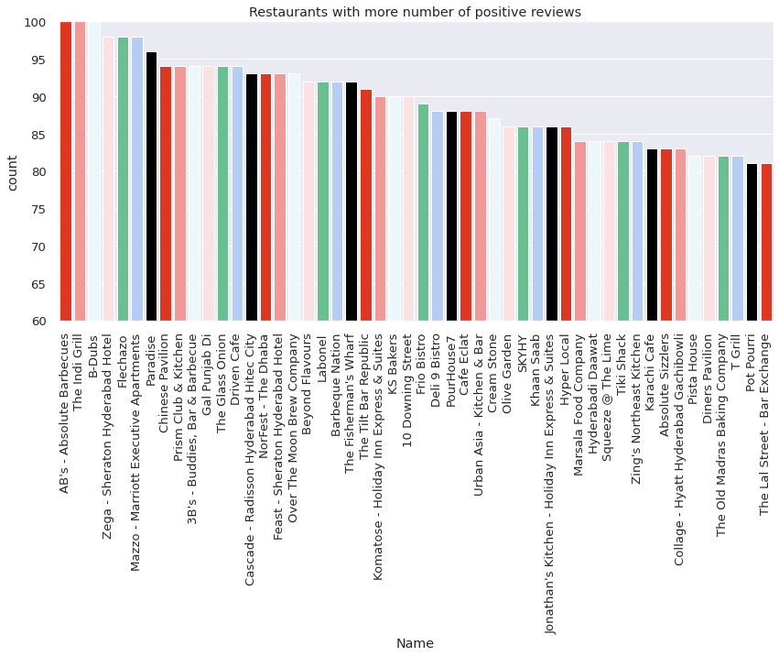
Restaurants with more number of positive reviews
AB’s – Absolute Barbecues was the restaurants having highest positive reviews

Slide 27
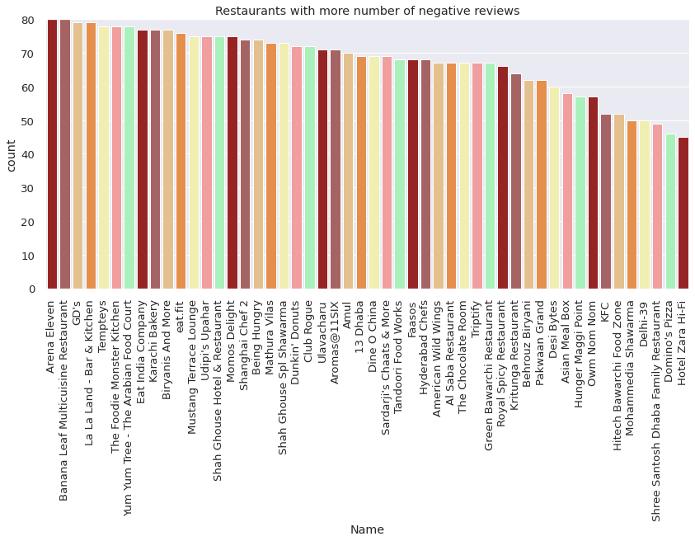
Restaurants with more number of negative reviews
Arena Eleven was the restaurants having highest negative reviews

Slide 28
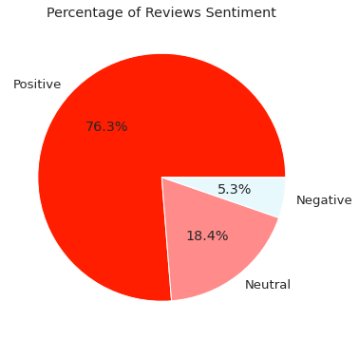
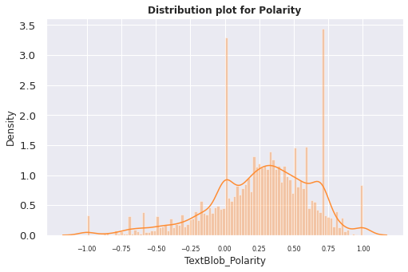
TextBlob Polarity
Reviews Sentiments
Distribution plot of polarity

Slide 29
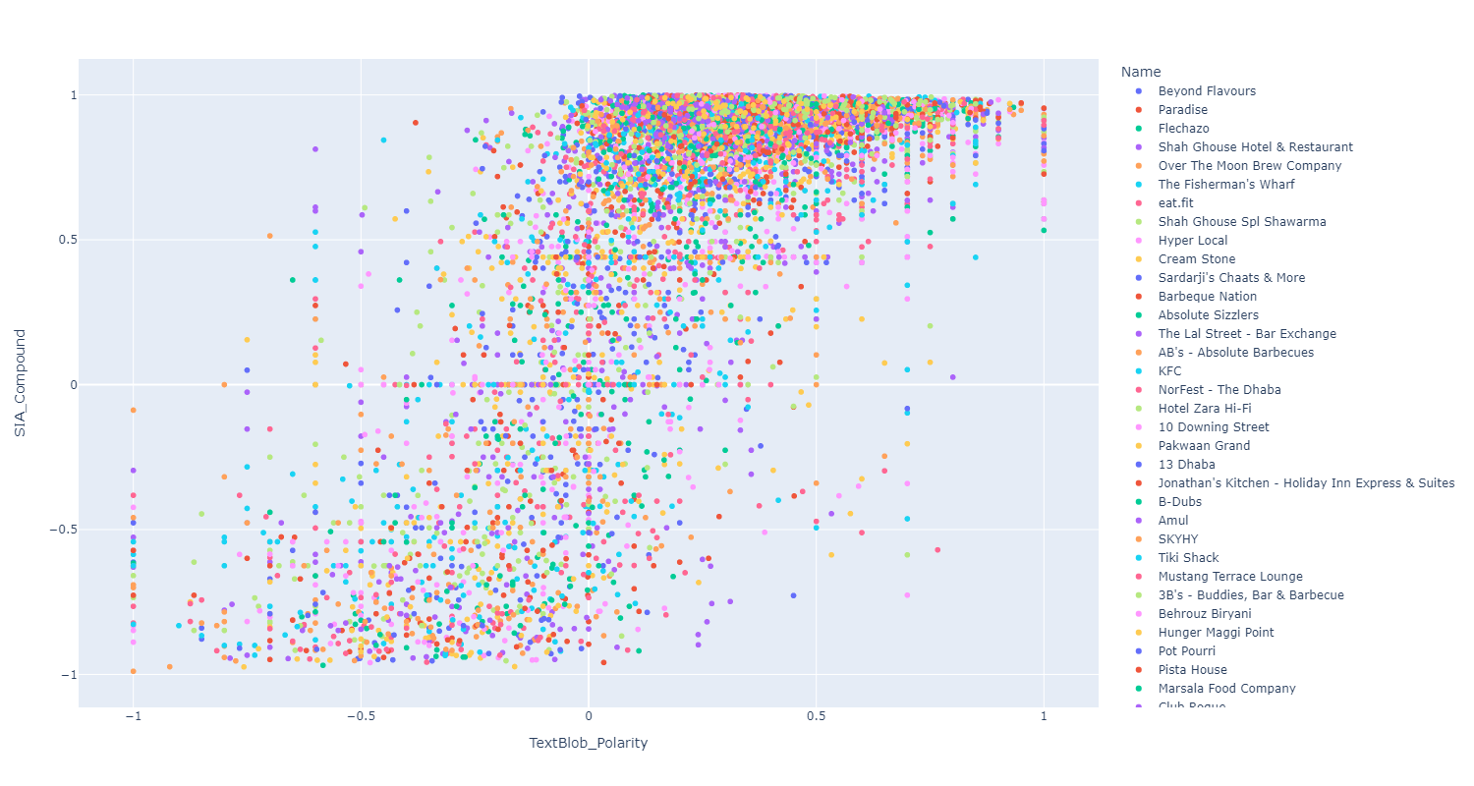
Model Comparison

Slide 30

CONCLUSION
North Indian Cuisine has the highest count among all
Collage - Hyatt Hyderabad Gachibowli is the expensive hotel with cost of 2800
Calculated k = 15 as optimum vale, for cuisine clusters.
Most of the hotels are given 5 Rating
Anvesh Chowdary was the most reviewer and given many hotel rating.
AB's - Absolute Barbecues has given most of the positive reviews and Arens Eleven got the highest negative review
Udipi's Upahar is Affordable Restaurant with best ratings
Club Rogue is Expensive Restaurant with worst ratings

Slide 31


